Slide 1
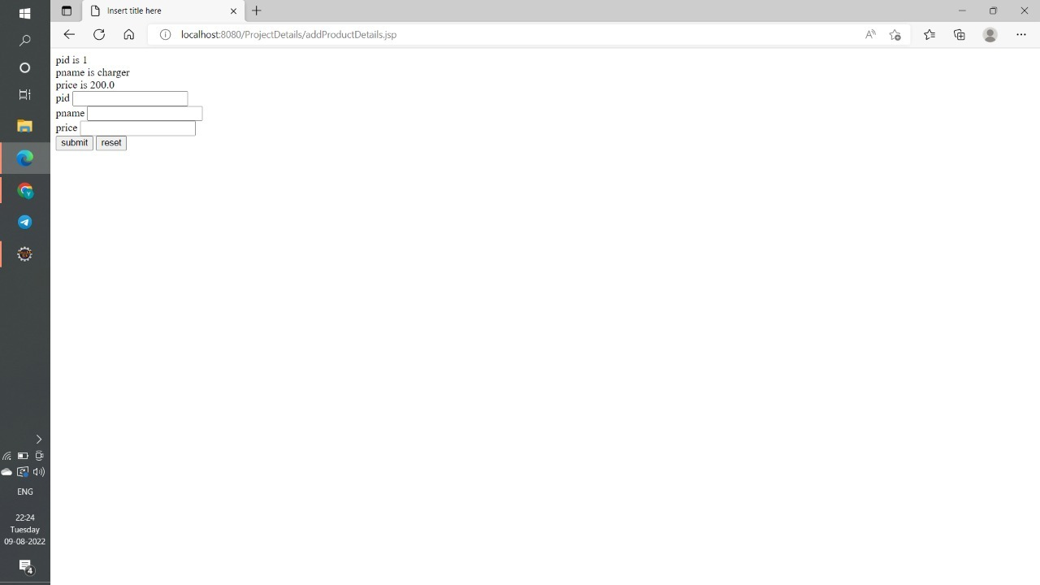
PRODUCT DETAILS PORTAL OUTPUT SCREENSHOTS

Slide 2


Slide 3
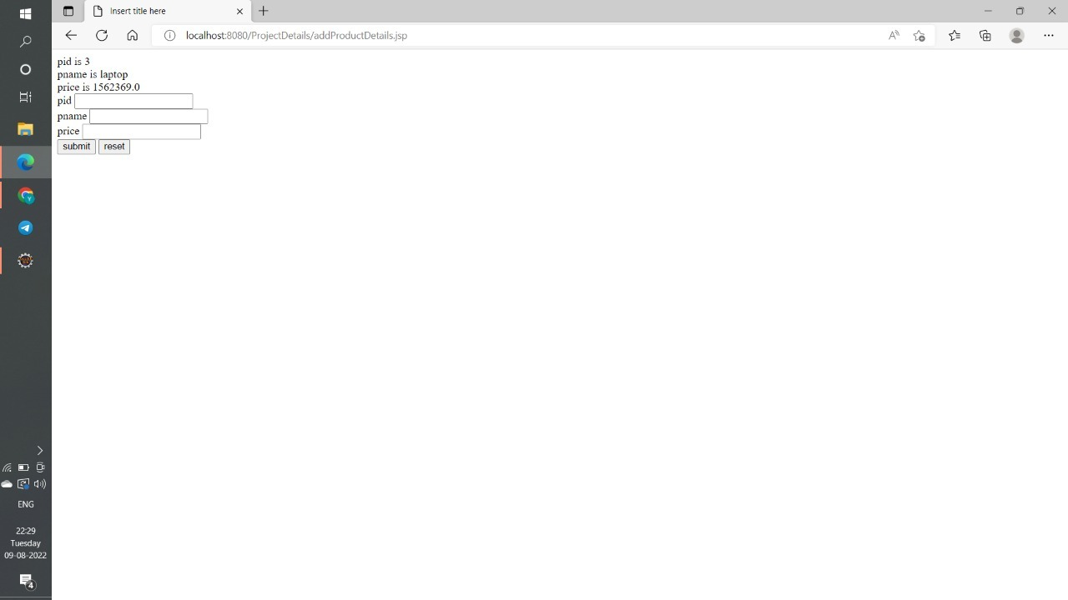

Slide 4


